Slide 1
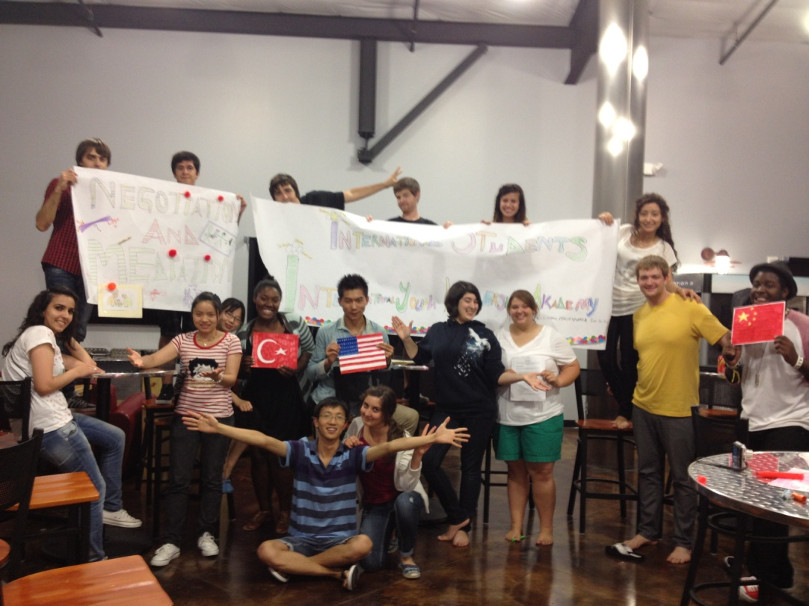

The WISE Foundation Work & Travel Program
www.wisefoundation.com

Slide 2
About WISE
WISE is short for The Foundation for Worldwide International Student Exchange.
Non-profit organization specializing in international education and exchange opportunities.
Designated by the U.S. Department of State as a J1 Visa Sponsor.
Who is WISE anyway?

Slide 3
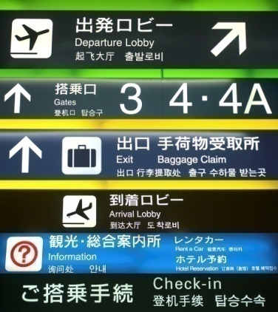
Why Go?
Have an exchange experience that allows the sharing of your culture and US culture!
The chance to live, work, and travel in the U.S.
Allows you to form friendships with people from all over the world.
Live independently in a foreign country.
Develop responsibility and maturity working in the United States.
What am I going to get out of going to the USA?

Slide 4

What Today is About
Things to know before arriving in the US.
Your arrival in the US.
Important information while in the US.
Day to day living in the US.
WISE contact information.
Your return home.
What am I going to get out of this orientation?

Slide 5
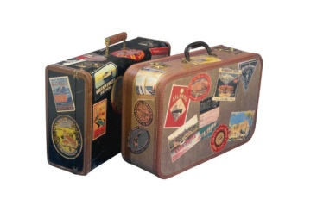
Things to Know Before You Go!
Applying for your J-1 Visa Stamp
Getting ready to go
Job Expectations
Housing Expectations
Personal Safety
What do I need to know before going to the USA?

Slide 6
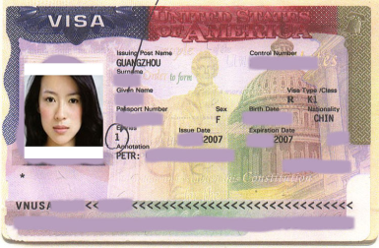
Applying for Your J-1 Visa Stamp
DS-2019 Form.
  Read both pages, sign and date.
  Bring with you to consulate.
Check on US Consulate requirements in your country.
  You may need an appointment.
  Other necessary papers to bring.
Plan ahead! Be aware that the visa process may take weeks!
How do I get into the USA?

Slide 7
Getting Ready to Go
Check on the weather for your destination.
Packing:
  Pack clothes according to weather.
  Be sure to bring at least 1 weeks worth of clothing.
  Bring clothes that will be comfortable to work in and that are acceptable to your employer.
  Do NOT bring valuables.
Arrange your transportation to your job site.
Money
  Bring at least $500-$800 as it will be at least 2-3 weeks before your first paycheck.
  Travelers checks, debit/credit cards are a good idea.
  Open a bank account upon arrival!
What do I need?

Slide 8
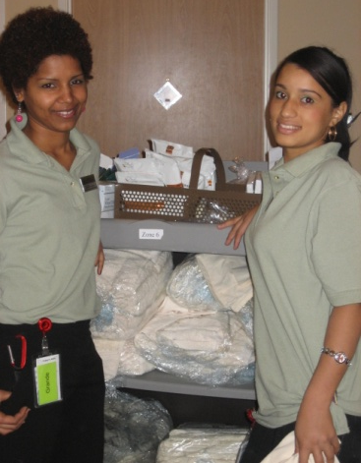
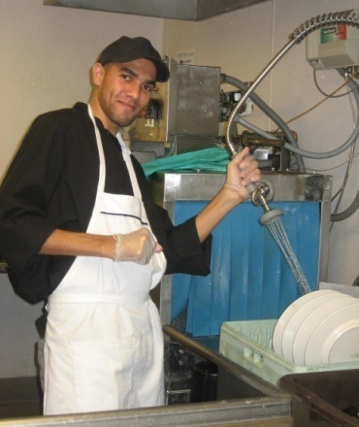
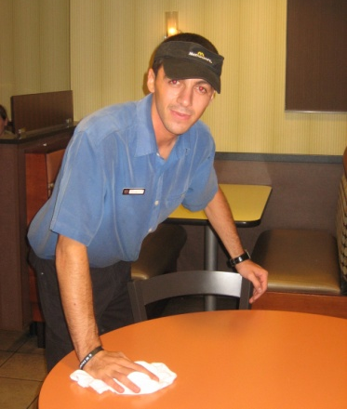
Job Expectations
Follow ALL rules of your employer
  You are subject to the same rules as all US citizens, residents, and full-time employees.
Grooming Standards
  Be prepared to meet conservative standards.
  Natural hair colors, shaving, ear piercings.
You may be expected to buy a uniform upon your arrival
Be prepared to work hard
What do I need to know about work?

Slide 9
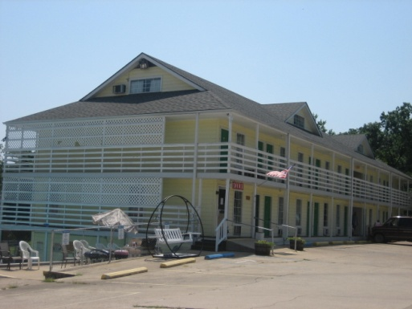


Housing Expectations
Know if your employer provides housing or if you are responsible.
Ask lots of questions: location, cafeteria or kitchen, laundry facilities, if it is furnished, etc.
You need to clean your own home.
What do I need to know about where I will live?

Slide 10

Personal Safety
Valuables.
Housing safety.
Transportation tips.
Drugs and alcohol.
Emergency contact information.
  Keep your WISE ID and insurance card with you at all times.
How do I stay safe?

Slide 11

Your Arrival in the USA
Things to Consider
Immigration
Validation of your Visa
Applying for your Social Security Number
Communication with WISE
I’ve arrived, now what?

Slide 12
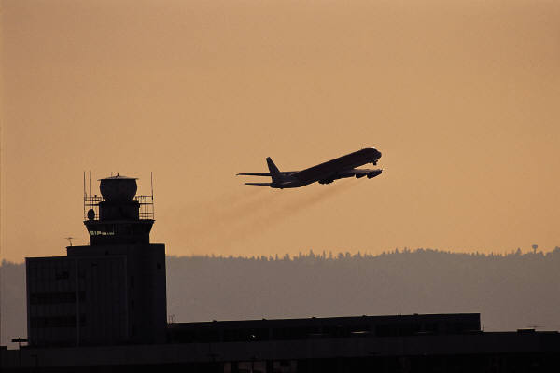
Arrival in the USA
Choose the best Airline for your location.
Airport & Transportation pick-up guidelines.
Show up at the correct airport.
Unless requested, do not arrive on weekends or late at night.
How do I arrive to my employer?

Slide 13
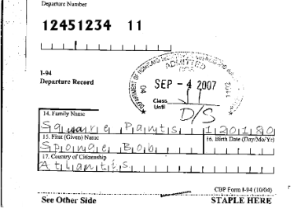
Immigration
On the airplane you will receive an I-94 card to complete.
  The details on the card must match your passport and DS-2019 form.
Make sure your I-94 card is stapled in your passport.
You will need the I-94 card to apply for your social security number and to leave the country.
How do I clear customs and immigration?

Slide 14
Validation of Your Visa
Contact WISE within 72 hours of arrival to US in order for your visa to be validated!
Validate online or by phone.
We must have the address where you live, not where you work.
Your visa MUST be validated at least 3 days before you apply for your social security card.
Failure to validate will put your program in jeopardy of being ended early by WISE!!
www.wisefoundation.com/work-and-travel/validation.html

Slide 15

Applying for Your Social Security Number
You must be in US for at least 10 days prior to applying for your social security card.
  You will receive your card faster if you wait 10 days before applying.
You must validate your visa 72 hours before applying for your social security number (SSN).
A social security card is required to work in the US.
You will need this number to pay taxes in the US.
Required documents to apply for SSN: passport, I-94 card, DS-2019 form, program sponsor letter, and job offer form.
If you already have a SSN, you DO NOT need to reapply.
How do I get a Social Security Card?

Slide 16

Communication with WISE
You must provide WISE with a valid email address at the time of your application
You must check your emails at least once a week.
You must respond to all monthly communication emails.
Your sponsorship may be withdrawn if we do not receive your response.
What is the key to my success on the program?

Slide 17

Important Information While in the USA
Cultural Exchange
Medical Insurance
Changing jobs and addresses
Leaving the program before your end date
Laws in the United States
Solving problems
What do I need to know while I’m in the USA?

Slide 18

Cultural Exchange
Cultural Exchange is the purpose of the J1 Work & Travel Program!
WISE will send communication prior to and during your program regarding cultural exchange opportunities in your host city and surrounding areas!
WISE strongly encourages you to take part in these opportunities.
Why did I come on the Work & Travel Program?

Slide 19

Culture Exchange
Easy ways to experience cultures include:
  Have a cook out
  Invite friends and neighbors for dinner were everyone brings a dish from their country
  Go to coffee with someone from another country
  Teach your friends your favorite sport from your home country
  Go for a hike.
  Attend your local youth hostel or university’s international coffee hour, lectures, movie nights, etc.
  Take an English course at a local university.

Slide 20
Medical Insurance
With your DS-2019 form, you will receive an insurance card and information.
What to do when you go to the doctor.
  Required paperwork.
Insurance does NOT cover pregnancy, dental, and preexisting conditions.
Co-Pay is $75-$150.
If you are injured on the job, tell your employer immediately. It will be covered by worker’s compensation.
www.wisefoundation.com/insurance.html

Slide 21

Changing Jobs and Addresses
You MUST contact WISE immediately before you make any changes!!
  WISE can help you with any problems you might have.
WISE requires that you keep us informed of your current living address at all times.
Prior approval by WISE is required for all job changes.
Contact WISE before changing jobs or moving!

Slide 22

Procedure for Changing Jobs
Changing jobs is possible but participants must provide the following for review and approval PRIOR to receiving permission from WISE:
  A $100 job fee will be charged to participants
  Job offer
  Host site Agreement
  Workers Compensation Policy
  copy of the employer’s business license
  Verification of Employers Tax ID #
How do I change Jobs?

Slide 23

Jobs you are NOT allowed to work:
There are certain jobs you are not allowed to work while on the W&T Program. Examples include:
  domestic help positions in private homes (e.g. childcare, elder care, gardener, chauffeur)
  as a pedi-cab or rolling chair driver or operator
  as operator of a vehicle or vessel that carriers passengers for hire and/or for which a commercial driver’s license is required
  positions requiring work hours that fall predominantly between 10:00p.m. & 6:00a.m.
Can I work any job that I want to?

Slide 24
Jobs which you are NOT allowed to work
When looking for a 2nd job, it is your responsibility to communicate with WISE about the position you are applying for. WISE will guide you as to whether the job is allowed or prohibited. If WISE declares that position to be prohibited, you may NOT work in that position. If you do work in a prohibited job your WISE Foundation Work & Travel Program will be end immediately

Slide 25
Leaving Your Program Before the End Date
You are required to complete the dates of your program.
Contact WISE if you have a family emergency or become ill.
What if something happens and I can’t finish my program?

Slide 26

Laws in the United States
You are subject to all the laws of this country.
Alcohol:
  Legal drinking age is 21.
  Open container laws.
  Buying Alcohol for someone under 21.
  Partying with someone under 21 who is drinking alcohol
If you do any of the following, you will immediately be dismissed from the program:
  Illegal drugs (including marijuana).
  Shoplifting.
  Driving without a driver’s license and car insurance.
  Stealing.
Can I party with my friends?

Slide 27
Solving Problems
You will have some problems.
  It will take time to adjust to a new situation.
First step: talk to your supervisor.
  They are there to help you!
Second step: contact WISE if problem continues.
Problems CAN be solved by talking it out. You cannot just quit your job.
Do what you can to avoid problems:
  Respect US laws, employer rules, and your sponsor’s rules.
What if I have a problem?

Slide 28

Day to Day Living in the USA
Life in the United States
Culture shock
Ways to reduce cultural stress
Communication
What do I need to know about living in the USA?

Slide 29
Life in the USA
Who are the American people?
  Informality, individuality, touching, time, friendliness, and hygiene-oriented.
Daily responsibilities:
  Laundry, cooking, cleaning.
What are some things I need to know about US culture?

Slide 30

Culture Shock
A period of adjustment to a new culture and environment.
  Occurs especially during the first few weeks of life in a new environment.
  Initial period of excitement followed by a realization of reality and sadness/depression.
You will be challenged and it will be hard.
  Large AND small changes in your daily life will affect you.
Any feelings you have are completely normal.
What is culture shock?

Slide 31

Ways to Reduce Cultural Stress
Have realistic expectations:
  Don’t expect the United States to be like your home country.
  Adjusting will take time.
Make friends while on program.
  Talk to other international students and co-workers.
Take care of yourself.
  Sleep, eat well, exercise.
Integrate yourself into US culture.
  Meal times, change your routines, etc.
  Take part in cultural activities that WISE informs you about.
Talk to your employer & WISE if you have any problems.
  We are all here to help you.
Reverse culture shock.
  Happens when you return home.
How do I deal with a different culture?

Slide 32

Communication
The most important tool to have – good communication with others.
Phone system:
  Local calls, area codes, long-distance, international calls, collect calls, phone cards.
US mail system:
  Sending mail: post office, postage.
  Receiving mail: know your living address.
How do I stay in touch with people?

Slide 33

WISE Contact Information
We are here for you, 24 hours a day.
WISE address:
  1853 Piedmont Rd. Suite 200
  Marietta, GA 30066
If you have any questions:
  Phone: 1-770-579-0567
    Monday through Friday 8am to 5pm EST.
  E-mail: worktravel@wisefoundation.com
For 24-hour assistance with emergencies:
  Call 1-888-242-7456.
  Memorize this number.
  FREE phone number from any phone.
How do I contact WISE?

Slide 34

Travel After Your Program
Due to the shortness of your program and the commitment made by your employer it will not be possible to take more than a day or two off at a time to travel during your program.
You are able to travel up to 30 days or until your university classes start back-whichever comes first.
Benefits of Travelling at the end of your program:
  More Cultural Exchange!!
  You can travel with your new friends!
  Fall weather.
  Off Season (Cheaper)
  Your English level will be much better.
  You can plan ahead and build a budget for your trip.
  You can plan your return ticket from a city you want to visit e.g. NYC, DC, Los Angeles…
  .
Can I travel at the end of my program?

Slide 35

Your Return Home
WISE Expectations
Taxes in the US
What do I need to know about returning home?

Slide 36

WISE Expectations
You are expected to return home upon completion of your program.
30 day grace period for travel.
Program evaluation form.
What do you expect regarding my return home?

Slide 37
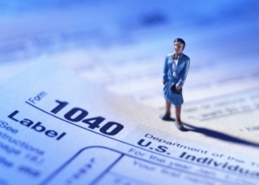
Taxes in the US
You are required to pay taxes on all money earned while in the US.
  You must receive a paycheck from your employer.
Generally, you will receive all of your money back from the government.
You will receive more information about taxes at a later date.
  Tax forms you will submit to the government (1040NR) can be found at www.irs.gov.
How do I get my tax money back?

Slide 38

On a Final Note….
How to have a Successful Program:
Realistic expectations.
Know and follow the rules and regulations of the WISE Work & Travel Program, and the laws of US government.
Read the WISE Participant Manual. Know what is expected of you.
Good communication between student, employer, overseas agent, and WISE!
How to be successful!

Slide 39

Any Questions?
?????????????????

Slide 40
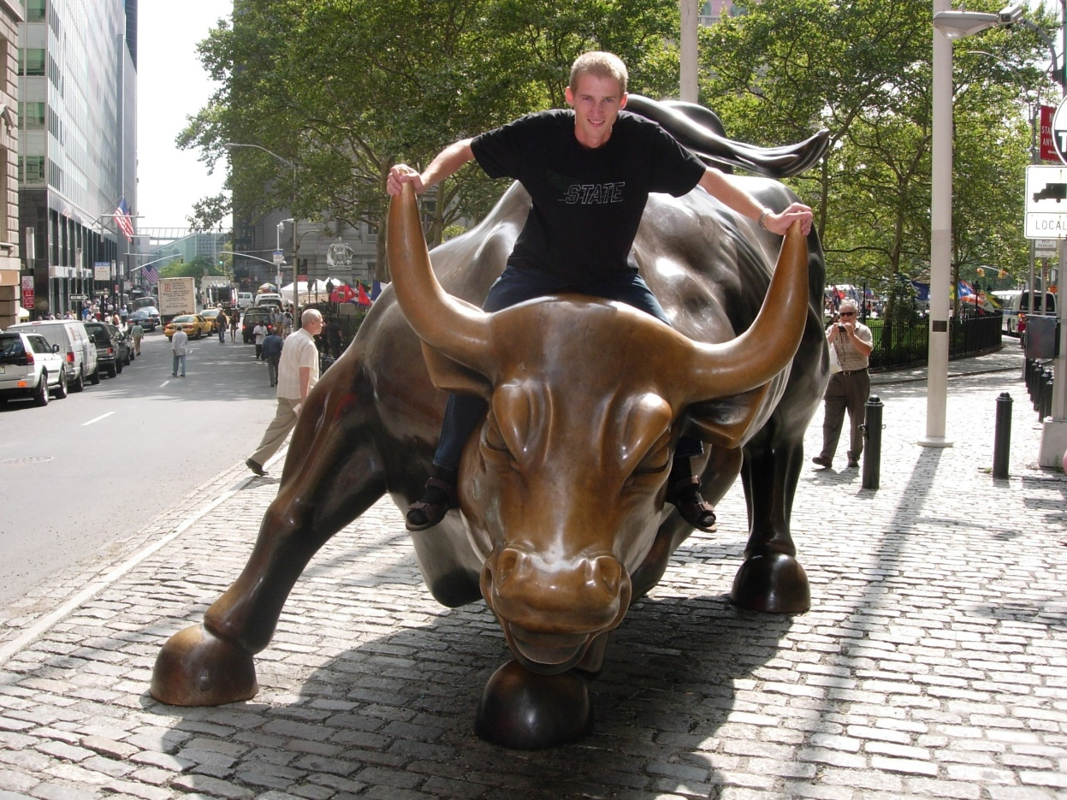
The WISE Foundation
www.wisefoundation.com

